Slide 1

Entertainer Data Analytics

Slide 2
INTRODUCTION
Normal life can be stressful, and people need to relax. Being entertained by others is a wonderful way to take some time out of life. It can reduce stress and make life's issues easier to face. The media and entertainment industry consists of film, television, radio and print. These segments include movies, TV shows, radio shows, news, music, newspapers, magazines, and books. The entertainment industry is a group of sub-industries devoted to entertainment. The entertainment industry is used to describe the mass media companies that control the distribution and manufacture of mass media entertainment.
Tool Use: Excel and Power Bi

Slide 3
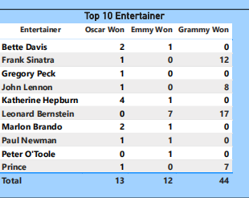
Top 10 Entertainer

Slide 4
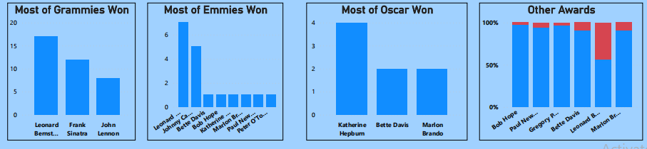
1.Most Grammies Awards
2.Most Emmies Awards
3.Most Oscar Awards
4.Other Awards

Slide 5
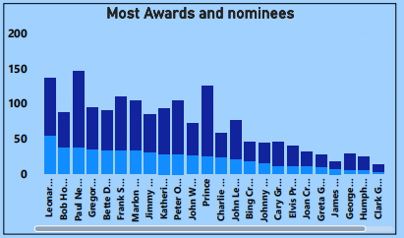

Slide 6
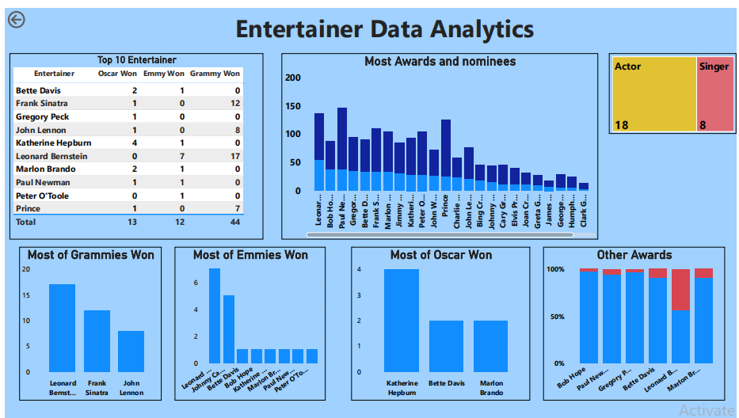
Final Dashboard

Slide 7
Thank You

